Slide 1

Hiring Process analytics
Pratiksha Shetty

Slide 2
Project Description
As a Data Analyst at Google, we will analyse the hiring process data to extract insights on rejections, interviews, job types, and vacancies to optimize the hiring process. Our objective is to extract meaningful insights from Google’s hiring process data to enhance efficiency and effectiveness in talent acquisition strategies.

Slide 3
Approach
The approach used to analyse the hiring process data at Google:
Handle missing data with required inputs
Identify outliers through statistical analysis.
Remove outliers cautiously to avoid skewing results.
Summarize findings with descriptive statistics and visualizations for insights.

Slide 4
Tech-Stack Used
As suggested we are using Microsoft Excel (Version 2021), the purpose is to analyse Google's hiring process data. This includes handling missing data, clubbing/adding columns, detecting and managing outliers, and summarizing findings through descriptive statistics and visualizations to derive insights for process improvement.

Slide 5
Data Cleaning : Renaming Columns
The column which was previously named as ‘Event-name’ was renamed to ‘Gender’ for improved comprehension and ease of use. This change will help enhancing the clarity on the dataset by providing a better descriptive label that accurately reflects the data it contains.

Slide 6
Data cleaning : Replacing Data
1) In the new column named ‘Gender’, there are unique data such as ‘Male’, ‘Female’, ‘Don’t Want to Say’ and ‘-’ and to enhance the data for better analysis we will replace ‘-’ with ‘Don’t Want to Say’
2) In ‘Post Name’ column, one data is provided as ‘-’, so we just renamed it to ‘Others’ for better consistency in data

Slide 7
Data cleaning : data consistency
We can standardize the format of the position name by replacing "c-10" with "c10" to ensure data consistency. This adjustment was made to align with the format used for all other positions, which did not contain hyphens

Slide 8
Hiring Analysis : Gender Distribution
Steps we followed to analysis the Gender distribution of the new hires are as follows:
1) Created a Pivot table with entire data set
2) Using ‘Gender’ and ‘Status’ columns, we will derive the number hires. Considering ‘Gender’ we will get the number of employees(hired and rejected) and then using ‘Hired’ as ‘Status’ filter we will obtain the Gender counts of all the hired employees
3) Based on the result, we will create a Visualization of data using a bar chart and to understand the distribution better we will use Pie Chart in the presentation

Slide 9
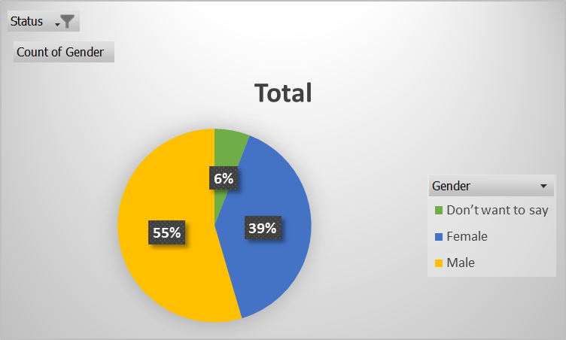
Hiring Analysis
Row Labels | Count of Gender
Don’t want to say | 278
Female | 1856
Male | 2563
Grand Total | 4697
Hiring analysis shows the Gender distribution among the new hires.
Among 4697 individuals hired, 2563 were Male whereas 1856 were Female and the rest 278 would not reveal their gender.
This analysis provides a valuable insights on how the gender distribution is among the newly hired talents.

Slide 10
Salary analysis : Average Salary
Here we wanted to analysis the average salary of all the employees who were hired by the company. We can calculate the average using AVERAGE function but here since we need the average only for the hired employee we have found Sum of salary & count of the employees who were ‘Hired’ only.
Formula used:
SUMIFS('Data Sheet'!G:G,'Data Sheet'!C:C,"Hired")/COUNTIF('Data Sheet'!C:C,"Hired")
Average Salary of Employees
49752.8961

Slide 11
Salary distribution : Class interval
We create a class interval for ‘Offered Salary’ to understand the Salary distribution across the company which will give idea about the range of Salary offered to the employees.
Here, we created a pivot table using ‘Offered Salary’ and the we used grouping on the distribution with minimum salary i.e. 100 to maximum salary offered i.e. 400099 with the interval of 10000 to understand the distribution of the salary.

Slide 12
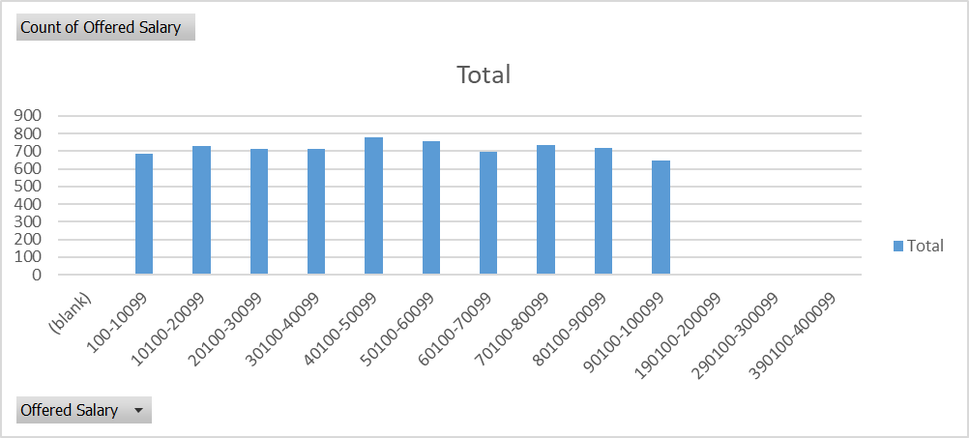
Salary distribution
Row Labels | Count of Offered Salary
100-10099 | 686
10100-20099 | 728
20100-30099 | 711
30100-40099 | 713
40100-50099 | 776
50100-60099 | 754
60100-70099 | 698
70100-80099 | 733
80100-90099 | 716
90100-100099 | 649
190100-200099 | 1
290100-300099 | 1
390100-400099 | 1
Grand Total | 7167

Slide 13
Departmental analysis
There are several departments in an organization, we need to understand the proportion of people working in different departments.
Here, we are first listing down the different department names and using a excel formula and function, deriving the number of people working in a particular department.
Formula used for Finance Department:
COUNTIFS('Data Sheet'!E:E, "Finance Department",'Data Sheet'!C:C,"Hired")
Similarly, we are getting count of each department by updating the Department name in the above formula.

Slide 14
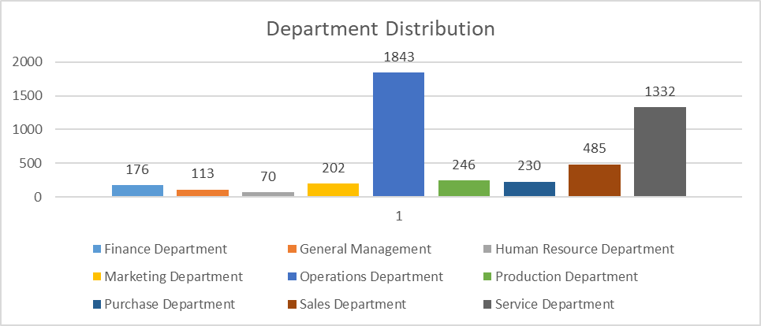
Department analysis
DEPARTMENT DISTRIBUTION
Finance Department | 176
General Management | 113
Human Resource Department | 70
Marketing Department | 202
Operations Department | 1843
Production Department | 246
Purchase Department | 230
Sales Department | 485
Service Department | 1332

Slide 15
Position tier analysis
We are analysing the various tiers available in the company to understand the distribution of positions across the company.
We are creating a pivot table of entire dataset, once pivot is created we are using ‘Post Name’ and ‘Status’ columns to analyze the data for the using ‘Hired’ filter on Status to only get the data of the employees of the company for further analysis.

Slide 16
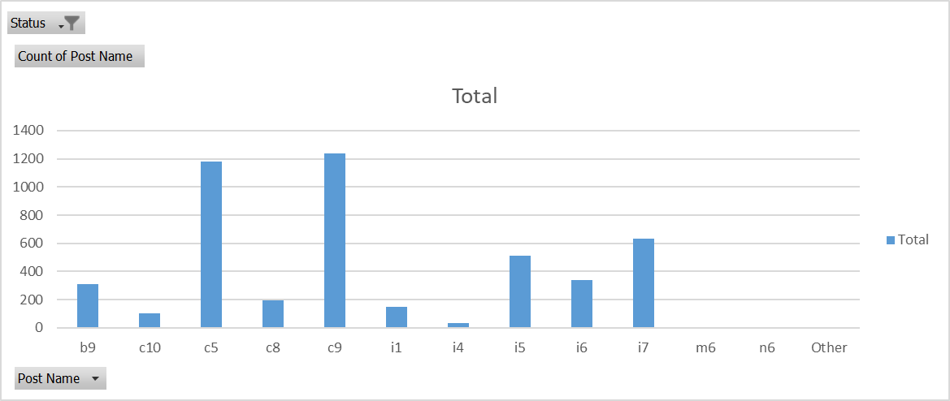
Position tier analysis
Row Labels | Count of Post Name
b9 | 308
c10 | 105
c5 | 1182
c8 | 193
c9 | 1239
i1 | 151
i4 | 32
i5 | 511
i6 | 337
i7 | 635
m6 | 2
n6 | 1
Other | 1
Grand Total | 4697

Slide 17
Insights
1) Hiring Analysis: Based on the hiring process analysis, it shows that more males have been hired compared to females. This is one of the important insights which shows the diversity of the workplace.
2) Salary Analysis: This analysis provided the average salary provided by the company which is important to set standards for the salary which is offered while hiring new employees.
3) Salary Distribution: Using the class interval for distribution of Salary, we gained the insights into the Salary distribution which is important for assessing the compensation provided.
4) Department Analysis: This analysis will provide a vision on various department and number of people working in each of them and help them hiring people to strengthen their respective departments
5) Position Tier Analysis: By analysing the different position tiers, we can gain the knowledge which will help in company’s hierarchical structure based on the roles and designations.

Slide 18
Achievements
Data Cleaning and Preparation: I effectively sanitized and organized the dataset by addressing missing data, adjusting column names, and eliminating anomalies. This preparatory phase was essential to ensure the analysis relied on precise and reliable data.
Average Salary Analysis: I calculated the mean salary offered by the company, which is a key metric for understanding the company's compensation practices in the job market.
Departmental Analysis: I employed a bar charts to visually represent the composition of employees across various departments. This graphical representation facilitates effective workforce management and allocation of resources.
Observations and Trends: By performing thorough analysis, I gathered insights into the recruitment process, gender diversity, salary structures, departmental structures, and position tier distributions within the company. These observations offer a comprehensive understanding of the company's recruitment practices.
Gender Distribution Analysis: I examined the gender breakdown among new hires, shedding light on the company's commitment to diversity and inclusivity. This insight is instrumental in promoting a well-rounded workforce.
Salary Distribution Analysis: I created a class intervals for salary ranges, allowing a better understanding of how salaries are distributed among employees.
Position Tier Analysis: I used charts to represent the distribution of different position tiers within the company. This analysis is crucial for identifying patterns in job hierarchies and career progression.

Slide 19
DRIVE Link
Raw Data - Hiring Dataset
Drive Link - Analysis Link

Slide 20
Thank you

